Slide 1
The Essay Writing Process and Essential Literary Elements
Mr. Wangelin
Freshman English &
American Literature

Slide 2
Introduction Paragraph
Intro consists of at least 4 sentences
Sentences:
Grabber – Gets the attention of the reader.
YOUR GRABBER IS NOT YOUR THESIS STATEMENT!!!
“Yes, true love is possible” is a thesis not a grabber!!!
Types of Grabbers:
Serious, straight forward broad statement
Dramatic or eye opening statement or statistic
Funny story or anecdote
Appropriate Quote
From the author
From the text/literature
From an expert in your topic

Slide 3
Intro paragraph cont’d
Sentence Number…
Development of the Grabber
Connects the grabber to the thesis
Explain what your grabber is referring to/ why it’s important
Thesis Statement
One sentence which states the topic and your point of view.
“Yes, true love is possible” is your thesis.
Plan of Development (P.O.D.)
One sentence which presents, in order, your 2 supporting/body paragraphs that support your thesis AND your counter argument.

Slide 4
Three supporting Paragraphs
Each paragraph will have the following qualities:
Topic Sentence (1st Sentence)
One sentence which begins with a transition and includes the thesis and the point from the P.O.D.
Supporting Sentences (Sentences 2-7)
A specific number of sentences which:
Explains
Provides Examples
Clarifies
Details
…the topic sentence
Concluding Sentence
One sentence at the end of the paragraph which restates the topic sentence.

Slide 5
Three supporting paragraphs cont’d
A GOOD Supporting Paragraph WILL contain AT LEAST 5-8 sentences!!!
The order of these sentences are as follows:
Topic Sentence
First reason sentence
Details for first reason sentence
Detail sentences explain in more detail your reason sentence or give examples.
If doing a research paper this is where you would put your evidence.
Second reason sentence
Details for second reason
Third reason sentence
Details for third reason
Concluding Sentence

Slide 6
Essay template
Paragraph 1 - Introduction
Paragraph 2 – Support #1
Paragraph 3 – Support #2
Paragraph 4 – Counter Argument
What would the opposition say?
Paragraph 5 - Conclusion

Slide 7
Transitions
Connect paragraphs and ideas together
Show that the speaker is moving on the next point.
A transition MUST be at the beginning of each supporting paragraph AND at the beginning of your “Reason Sentences”.

Slide 8
Concluding Paragraph
Has at LEAST four sentences!
Restate the thesis
One sentence that restates the thesis and begins with a transition.
“In conclusion, true love is possible…”
To reword your conclusion so that it doesn’t sound redundant you may want to use a thesaurus.
Summary of P.O.D.
One sentence that simply restates the P.O.D.
“Like Romeo and Juliet, true love is possible because Reason 1, Reason 2, & Reason 3.”
Opposing View Point
One sentence that states what the opposition would say about your topic.
Universal Application
One sentence that provides:
Solution to your topic/issue
Importance of your topic
Lesson to be learned from your topic

Slide 9
Miscellaneous information
DO NOT WRITE IN THE FIRST PERSON!!
No “I” or “you”
Unless the teacher/prompt gives you permission – “In your opinion”
Do not use contractions
Can’t = cannot
Don’t = do not
He’ll = he will
Etc…
Mr. Wang’s Rule of Three:
Your topic sentences/reasons must be supported by THREE reasons (Reason Sentences)
Obviously use proper English and Grammar
Absolutely no:
“Text Talk”
Slang
Short hand/Abbreviations
“You” is spelled y-o-u not “u”

Slide 10
Format
Double Space ENTIRE essay.
12 point Times Roman Font
MUST have a heading
Top Left Corner
Your Name
Wangelin
English 9
Date
Title
Double Space
Center
Follow Rules of Capitalization

Slide 11
Essential Literary elements
Plot – the sequence of events in a story. Revolves around a conflict.
Exposition – sets the tone, establishes setting, introduces characters, and gives important background information.
Rising Action –Action prior to the climax. Adding complications or expand the conflict.
Falling Action – The events after the climax. Ties up loose ends.
Climax – Emotional intensity hits its peak. Highest point of action.
Hint: One way to identify the climax is when the main character has to make a decision that changes the outcome of the story.
Resolution – The conclusion or ending of the story. What happened?

Slide 12
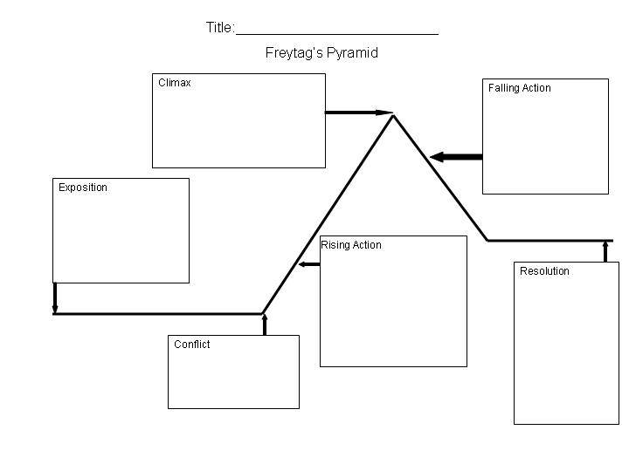
Freytag’s pyramid

Slide 13
Essential Literary Elements Cont’d
Setting – Time and place of the story
Conflict – Struggle between opposing forces
External – Character vs. outside force
Internal – Character battles within himself
Four types of conflicts:
Man vs. Man
Man vs. Nature
Man vs. Society
Man vs. Himself
Theme –The main idea in fiction, not always stated directly. (The lesson to be learned from the novel)

Slide 14
Essential Literary Elements Cont’d
Character Development – How a character changes from the beginning to the end of a story.
Mood – The feeling or atmosphere of a story.
Tone – The attitude a writer takes
Funny/Serious
Author’s Purpose – Why the author wrote the story.
Express
Inform
Persuade
Entertain
Point of View – The point of view of the narrator.
1st person – Narrator is in the story
Can only see, hear, feel, what they perceive
Cannot read/hear thoughts
3rd person – Narrator is not in the story and tells the story as it is perceived.
3rd person omniscient – Narrator is “God like” – Knows all, sees all

Slide 15
Literary Elements
Antagonist- The character whom opposes the main character.
Protagonist- The main character in a drama or other literary work; usually seen as the hero.
Fiction- Novels and stories that describe imaginary people and events.
Nonfiction- Story told with factual information. (Real)

Slide 16
Literary Elements
Personification- A figure of speech in which inanimate objects or abstractions are endowed with human qualities or are represented as possessing human form
Symbolism- when certain special figures, characters, objects or marks are used to suggest something else. Usually an idea, thought, or abstract thing. (Example- The American flag symbolizes liberty, freedom, and strength.

Slide 17
Literary Elements
Simile – Compares two things using “like” or “as”.
Example: The light was as bright as the sun!
Metaphor – Compares two unlike things, without using “like” or “as”.
Example: The dog had the speed of a cheetah.
Allusion - a reference in a literary work to a person, place, or thing in history or another work of literature.

