Slide 1
To Kill a Mockingbird
Historical Background Information

Slide 2
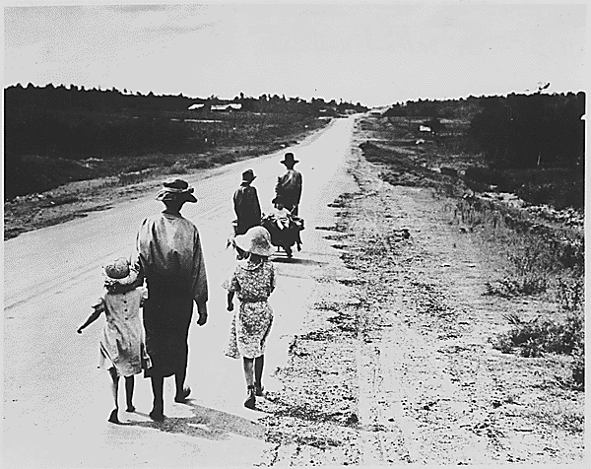
The Great Depression
What was it??
Worst and longest economic collapse in the history of the modern industrial world.
How long did it last?
End of 1929 to the early 1940s.
Who did it affect?
All of the world’s industrial countries who had become reliant on each other, including the United States.
Notes:
Christmas dinner in the home of Earl Pauley near Smithland, Iowa. (Circa 1935)
Homeless family, tenant farmers in 1936.

Slide 3
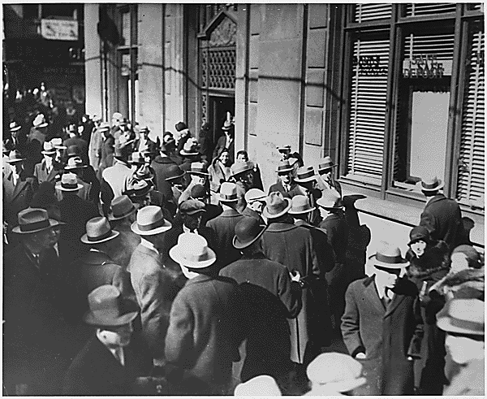
The Great Depression
What happened?
Rapid declines in the production and sale of goods and a sudden, severe rise in unemployment.
Businesses and banks closed their doors, people lost their jobs, homes, and savings, and many depended on charity to survive.
In 1933, at the worst point in the depression, more than 15 million Americans—one-quarter of the nation’s workforce—were unemployed.
(There were approximately 6.8 million in 2007)
Notes:
Breadlines: long line of people waiting to be fed: New York City: in the absence of substantial government relief programs during 1932, free food was distributed with private funds in some urban centers to large numbers of the unemployed.
"Runs on Banks": people milling about outside of bank. (Circa 1933)

Slide 4
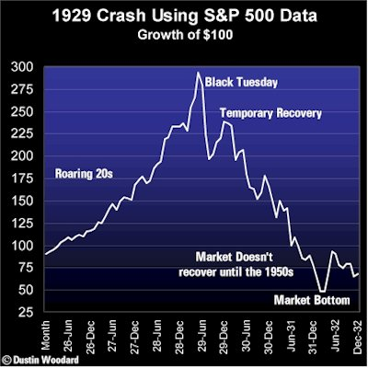
The Great Depression
What caused the depression??
The depression was caused by a number of serious weaknesses in the economy.
In the 1920’s, income was unevenly distributed.
The wealthy made large profits, but more and more Americans spent more than they earned.
Farmers faced low prices and heavy debt.
Black Tuesday 1929.
Notes:
Street scene on Black Thursday, Oct. 24, 1929, the day the New York stock market crashed and the day that many mark as the beginning of the Great Depression.
Line graph of the 1929 Stock Market Crash.
The Stock Market Crash of 1929 was NOT the cause of the Depression

Slide 5
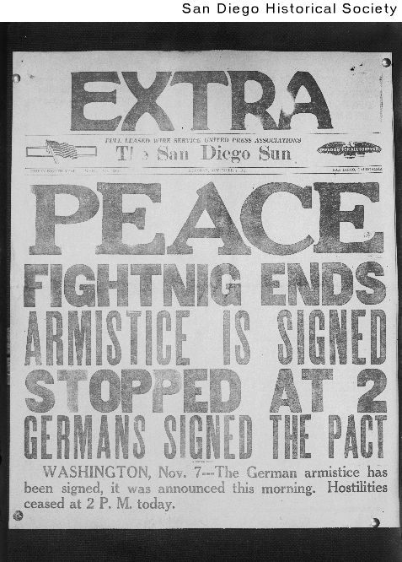
The Great Depression and World War I
The lingering effects of World War I (1914-1918) caused economic problems in many countries, as Europe struggled to pay war debts and reparations.
Question: What are reparations?
Answer: Compensation in money, material, labor, etc., payable by a defeated country to another country or to an individual for loss suffered during or as a result of war.
Notes:
World War I on Pribilof Islands off of the coast of Alaska, peace (Nov. 11, 1918)
November 7 1918 San Diego Sun

Slide 6
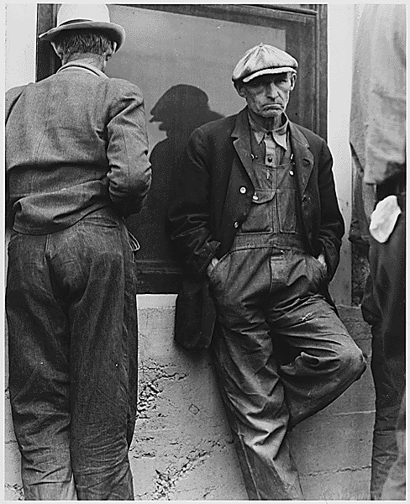
Life During the Depression-Men
It was devastating to many people, who not only lacked adequate food, shelter, and clothing but felt they were to blame for their desperate state.
Although few people died from starvation, many did not have enough to eat. Some people searched garbage dumps for food or ate weeds.
Because society expected a man to provide for his family, the psychological trauma of the Great Depression was often more severe for men than women.
Notes:
Typical picture capturing the number of people who were unemployed and looking for a job. (Circa 1935)
Everywhere the unemployed stood in the streets, unable to find jobs and wondering how they could feed their families. (Circa 1935)

Slide 7
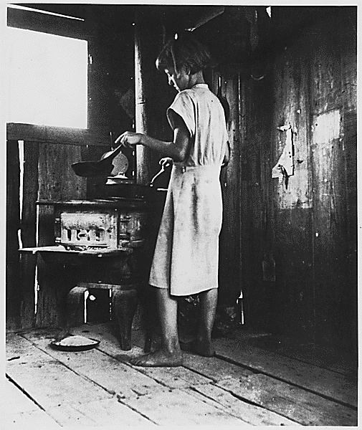
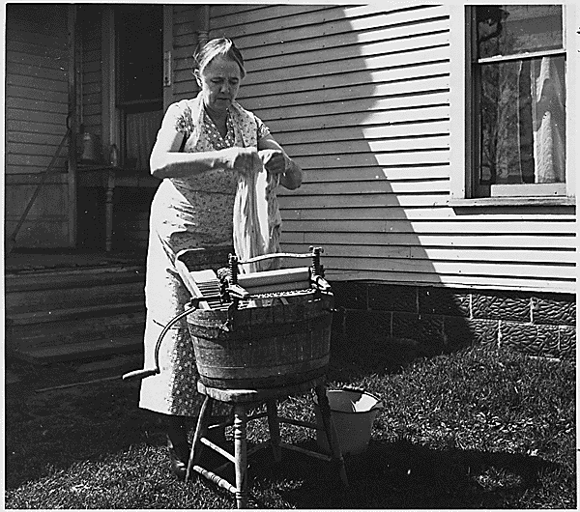
Life During the Depression-Women
Many men argued that women, especially married women, should not be hired while men were unemployed.
Women had been excluded from most of the manufacturing jobs that were hardest hit by the depression, which meant they were less likely than men to be thrown out of work.
Notes:
the percentage of women in the workforce actually increased slightly during the depression, as women took jobs to replace their husbands’ lost pay checks or to supplement spouses’ reduced wages.
. Some fields that had been defined as women’s work, such as clerical, teaching, and social-service jobs, actually grew during the New Deal.

Slide 8
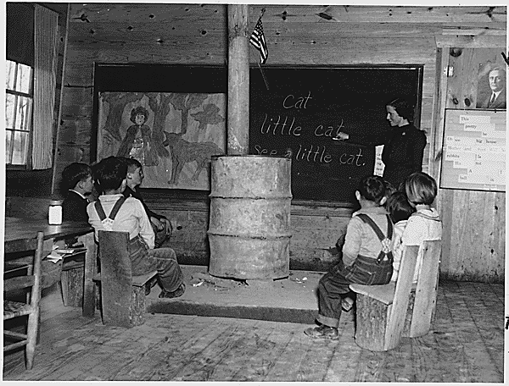
Life During the Depression-Children
During the depression many children took on greater responsibilities at an earlier age than later generations would.
Because many children went to work or simply could not afford to go to school, many children were uneducated.
Notes:
Teenagers found jobs when their parents could not, reversing the normal roles of provider and dependent.

Slide 9
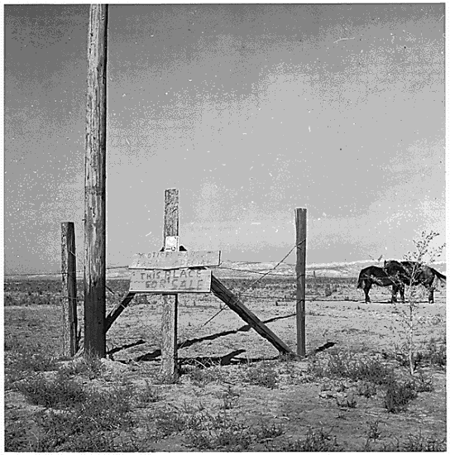
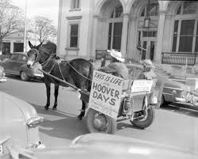
Life During the Depression-Hoovervilles
Notes:
Shantytowns formed in cities across the United States in the 1930s, built by people made homeless by the Great Depression. The areas, like this one in Seattle, were nicknamed Hoovervilles because their inhabitants blamed President Herbert Hoover for their plight.

Slide 10
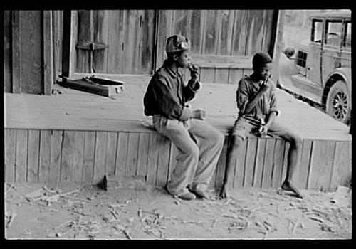
Life During the Depression-Minorities
Since they were “born in depression,” many blacks scarcely noticed a change at the beginning of the 1930s.
Over time blacks suffered to an even greater extent than whites, since they were usually the last hired and first fired.
Notes:
By 1932 about 50 percent of the nation’s black workers were unemployed. Blacks were frequently forced out of jobs in order to give them to unemployed whites.
Rural Rehabilitation; "Quilting project"; Rock Crest School, Chambersburg TWP., Iredell Co., N.C.
Homeless African American children
Other minority populations had experiences similar to those of blacks during the depression. Native Americans were even less likely than blacks to notice a downturn when the depression began; they already fared poorly by virtually every social or economic indicator. But Native Americans, like blacks, were brought into New Deal relief programs that in theory did not discriminate, and an attempt was made, through the Indian Reorganization Act, to enable tribes to reestablish their identities and cultural practices. In industrial cities such as Detroit, Gary, and Los Angeles and in agricultural regions such as California’s San Joaquin Valley, Mexican Americans were seen as holding jobs that should go to whites. Repatriation (meaning deportation) programs were instituted to persuade Chicanos to return to Mexico, often through intimidation.

Slide 11
Life During the Depression-Minorities
Other minority populations had experiences similar to those of blacks during the depression.
Native Americans were even less likely than blacks to notice a downturn when the depression began.
Indian Reorganization Act (New Deal)
Notes:
they already fared poorly by virtually every social or economic indicator. But Native Americans, like blacks, were brought into New Deal relief programs that in theory did not discriminate, and an attempt was made, through the Indian Reorganization Act, to enable tribes to reestablish their identities and cultural practices.
Here, Mohawk ironworkers put up steel for the United Nations General Assembly building in 1952. Some Mohawk continue to work as ironworkers today.

Slide 12
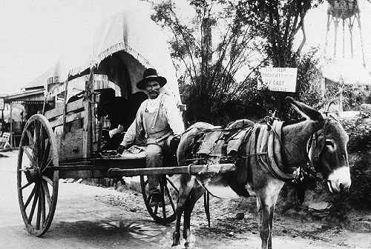
Life During the Depression-Minorities
Question: What does Repatriation mean?
Answer: Repatriation means deportation.
In industrial cities such as Detroit, Gary, and Los Angeles and in agricultural regions such as California’s San Joaquin Valley, Mexican Americans were seen as holding jobs that should go to whites.
Repatriation programs were instituted to persuade Chicanos to return to Mexico, often through intimidation.

Slide 13
The New Deal
What was it??
The peacetime domestic program of United States president Franklin D. Roosevelt.
Innovative measures taken between 1933 and 1938 to counteract the effects of the Great Depression.

Slide 14
The New Deal In a "Nutshell"
“The New Deal helped people to survive the depression, but acted as a painkiller rather than a cure for the nation’s economic ills. Unemployment was reduced, but remained high through the 1930s. Farm income rose from a low of $1.9 billion in 1932 to $4.2 billion in 1940. The demands of the depression led the United States to institute social-security programs and accept labor unions, measures that had been taken decades earlier in many European nations.”
-MSN Encarta

Slide 15
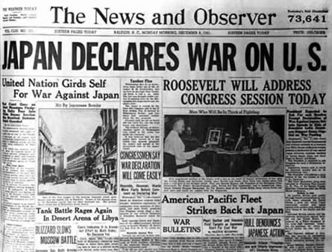
The End of the Depression
The New Deal did NOT bring the US out of the Depression, it merely helped.
It was not until World War II that the economic conditions began to grow.
The US government began to:
Expand the National Defense System
Produce ships, aircraft, weapons, and other war materials
The War stimulated growth and dropped the unemployment rate.
Unemployment was actually replaced by a shortage of workers.

Slide 16
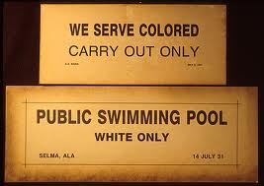
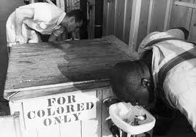
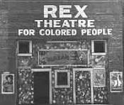
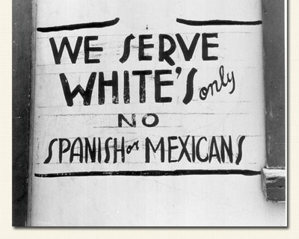
Jim Crow
What was it?
Racial class system
Unwritten laws that made segregation legal.
1877-1960s
Plessy vs. Ferguson
Legalized “Separate But Equal”
Equality is a relative term
Lynching acceptable

Slide 17
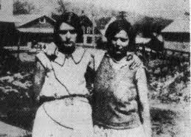
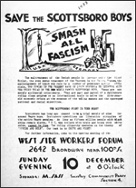
Scottsboro Trials
Nine Black teenagers accused of Rape
1931
Showed the injustices of Blacks in the American legal system
Reason why Harper Lee wrote TKM
Scottsboro: An American Tragedy

Slide 18
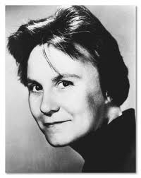
Harper Lee
Born on April 28, 1926 in Monroeville, Alabama
TKAM takes place in Maycomb, AL
Youngest of four children
1957 – submitted manuscript for her novel; was urged to rewrite it
Spent over two years reworking it
1960 – To Kill a Mockingbird (her only novel) published
1966 - was one of two people named by President Johnson to the National Council of Arts
Harper Lee Biography

Slide 19
TKAM Information
Story is told as a FLASHBACK
Setting:
1930s
Great Depression
Jim Crow
Maycomb, AL
Small Rural Town
Distinct Social Classes
Point of View
First Person
Narrator - Scout

Slide 20
Main Characters
Scout (Jean Louise Finch) – six-year-old narrator of story
Jem (Jeremy Finch) – her older brother
Atticus Finch – Jem and Scout’s father, a prominent lawyer who defends a black man accused of raping a white woman
Arthur (Boo) Radley – a thirty-three-year-old recluse who lives next door
Charles Baker (Dill) Harris – Jem and Scout’s friend who comes to visit his aunt in Maycomb each summer
Tom Robinson – a respectable black man accused of raping a white woman
Calpurnia – the Finches’ black cook

Slide 21
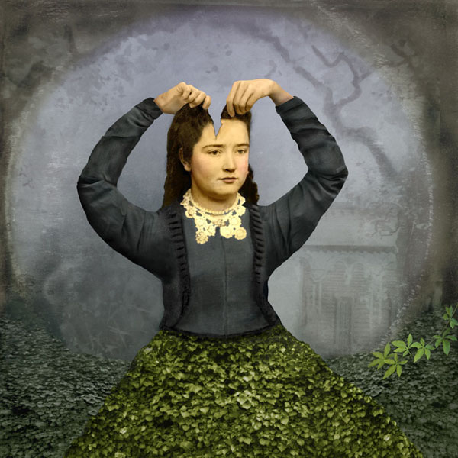
Southern Gothic
in American Literature
Laurie Miller

Slide 22
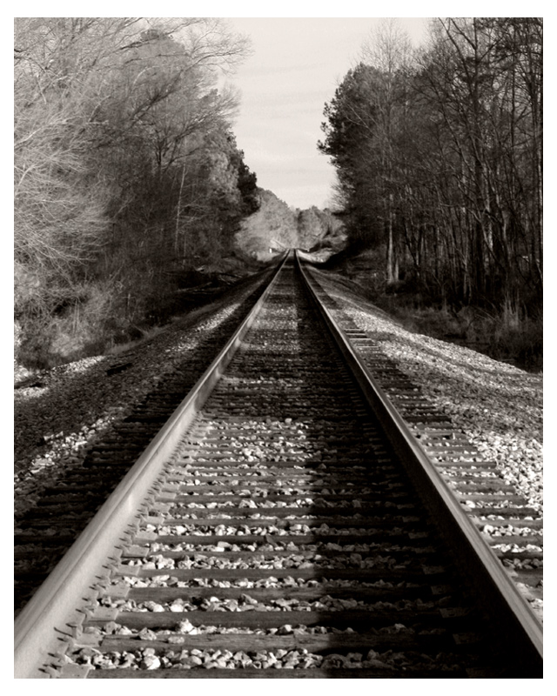
Background
Sub-genre of the Gothic style
Popular in Europe in 1800s
Frankenstein by Mary Shelley
Dracula by Bram Stoker
Unique to American literature
relies on supernatural, ironic or unusual events to guide the plot
uses these to explore social issues and reveal the cultural character of the American South.

Slide 23
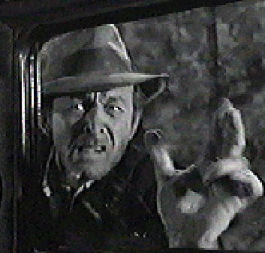
Background
Takes classic Gothic archetypes, such as the monster or the heroic knight, and turns them into American Southerners
a spiteful, reclusive spinster; an uneducated drunk
a quiet, wise lawyer
Most notable feature is the “grotesque”
a character whose negative qualities allow the author to highlight unpleasant aspects in Southern culture.
Something in the town, the house, the farm is bizarre and often falling apart

Slide 24
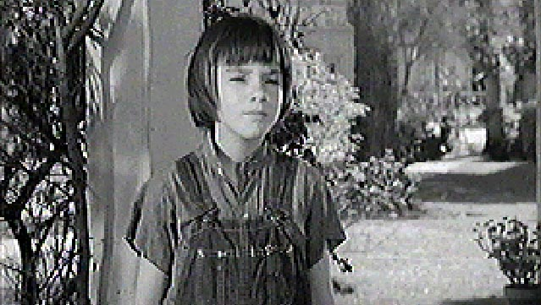
Defining Feature
Cast of off-kilter characters
Broken bodies, minds or souls
Used to symbolize problems created by the established pattern
Used to question established pattern’s morality and ethical justification
The “Innocent” is a common character, who may or may not be “broken,” but who often acts as a redeemer for others

Slide 25
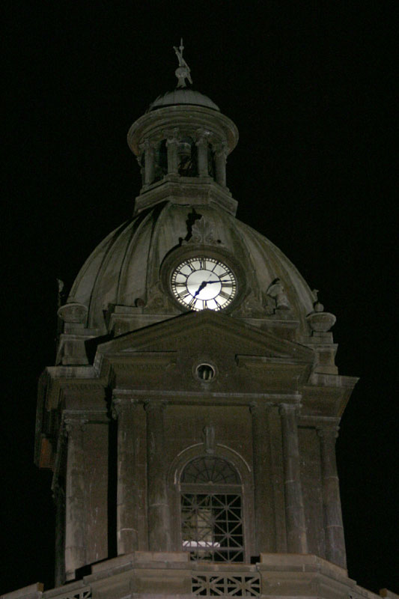
Other Specific Features of Southern Gothic
Freakishness
Outsider
Imprisonment
Violence
Sense of Place

Slide 26
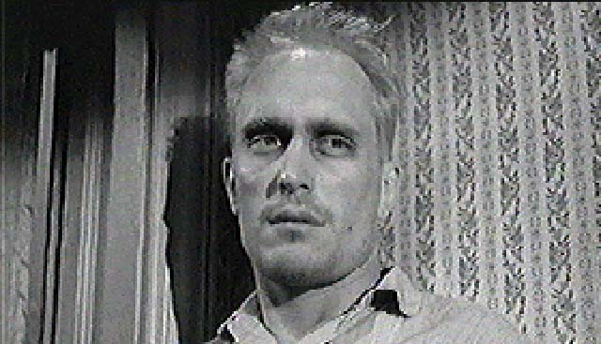
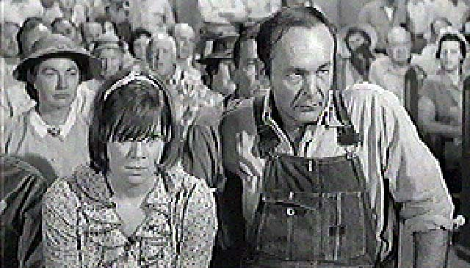
Freakishness
In most southern gothic stories, there is an important character who is set apart from the world by in a negative way by a disability or an odd, and often negative way of seeing the world.

Slide 27
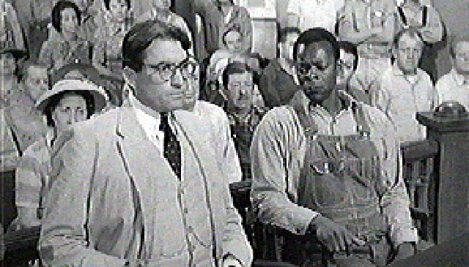
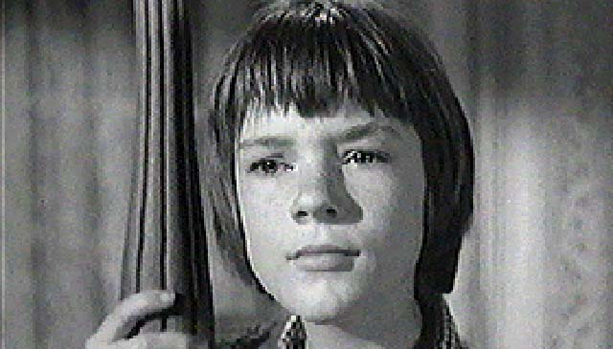
Outsider
Southern novels are filled with characters who are set a part from the established cultural pattern, but who end up being heroes because their difference allows them to see new ways of doing things that ultimately help to bring people out of the “dark.”

Slide 28
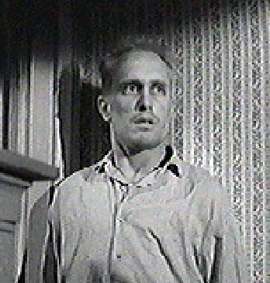
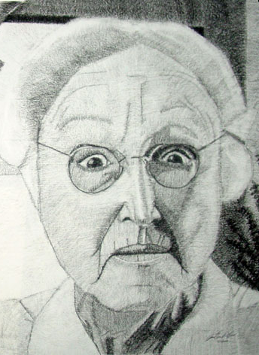
Imprisonment
This is often both literal and figurative.
Many southern gothic tales include an incident where a character is sent to jail or locked up.
There are also Southern gothic characters that live in fate's prison.

Slide 29
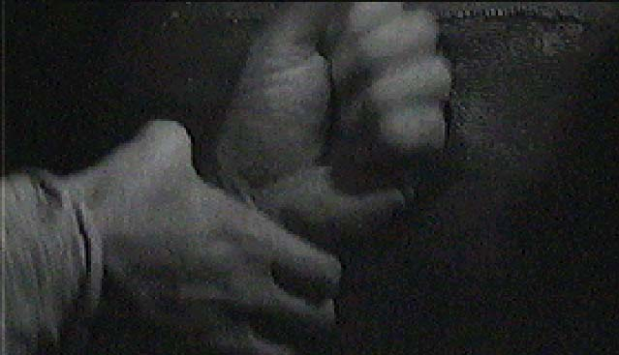
Violence
Racial, social and class difference often create underlying tension in Southern gothic novels that threatens, and usually does, erupt in violent ways

Slide 30
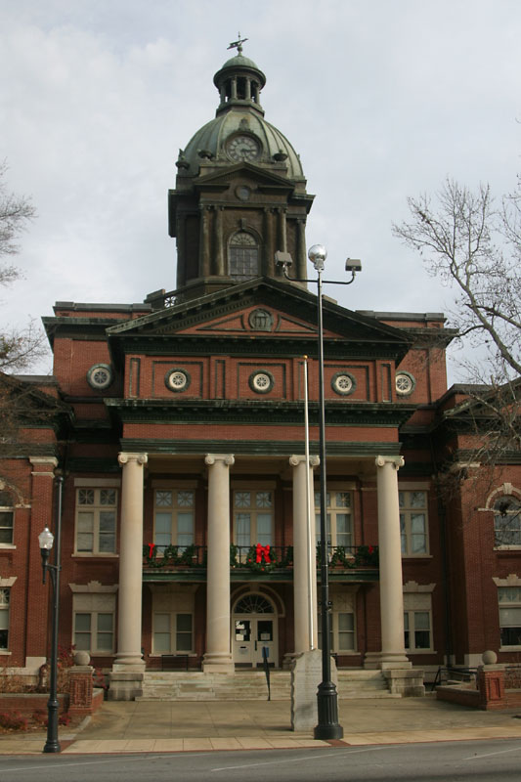
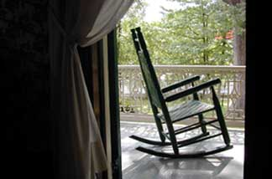
Sense of Place
You can’t read a Southern Gothic novel without understanding what a Southern town “feels” like:
old small towns
Houses have front porches with rocking chairs
Old downtown with stately but worn-down buildings

Slide 31
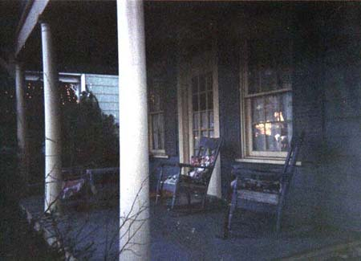
The End

Slide 32
Credits
“Southern Gothic” painting available @ http://www.internationaldigitalart.com/IDAA/2005IDAAGallery/pages/029_southern_gothic.html
To Kill a Mockingbird Pictures available @ http://www.foothilltech.org/rgeib/english/tkm/culminatingproject/pictures/
Genre information available @
http://en.wikipedia.org/wiki/Southern_Gothic
http://www2.oprah.com/obc_classic/featbook/thlh/gothic/thlh_gothic_main.jhtml
http://www2.oprah.com/obc_classic/featbook/thlh/gothic/thlh_gothic_features.jhtml

Slide 33
How to Summarize
Summarizing is condensing an original piece of writing so that it contains only the most important information.
The thesis should be very clearly indicated, and the entire summary should be in your own words without quoting the article.
One-fifth (20%) to one-quarter (25%) in length
Plagiarism is unacceptable at any time, and this is especially true while summarizing.

Slide 34
How to Summarize Tips for Writing
Read the original carefully.
Next, group the original writing into related paragraphs or sections.
Then write a one or two sentence summary for each group of related paragraphs.
Write one sentence which gives the main idea or thesis of the entire writing.
In writing the first draft of the summary, be sure to be reader-friendly and start with a summary introduction, which includes the name of the article or book, the author and if appropriate the date and name of the journal, magazine or newspaper in which the article appeared.
In your final draft, eliminate repetitions and generally make your summary coherent.

Slide 35
Summary Format
Same Format as 5 Paragraph Essay
Double Space
12 Font
Times New Roman
Must be in paragraph form – NO LISTING!!
Heading/Header
Your Name
Teacher
Class and Hour
Date
Header in Top Right – Name and Page Number

Slide 36
Summary Must Include
Brief description of who Jim Crow was.
Etiquette blacks had to follow.
Laws that were created –
Must include Plessy case.
Punishments for breaking Jim Crow Laws
Lynching’s and other punishments
The Race Riots that occurred as a result of Jim Crow.
Include the details of the “Red Summer”

Slide 37
Emmett Till Focus Question
Based on what you know about the Jim Crow Era, its laws, etiquette & punishments, what led to the murder of Emmett Till?
Answer Plan
Briefly explain the circumstances behind his murder.
Explain what Jim Crow was and what did Jim Crow have to do with his murder?
Why would Emmett not know about the Jim Crow Laws? (Think about where Jim Crow laws were prevalent)
Be specific as possible.
Should be like a body paragraph with an intro and a conclusion.

